Slide 1
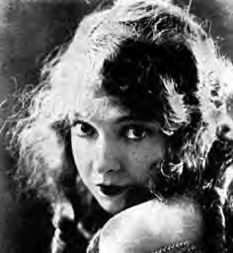
Images and Representation
Thoughts on Early Cinema
Presentation created by David C. Simmons
Ideas by David C. Simmons, Mark Hamilton, and Dr. Kay Picart
Edited by Michaela Densmore and Dr. Kay Picart ©2001

Slide 2
Aims of this Class Session
Review several of Lippmann’s concepts of stereotypes and how they function in Battle at Elderbush Gulch.
Demonstrate how IMR (Classical Holly-wood Cinema) positions the (assumed white, male, middle-class, heterosexual) spectator within the diegesis.

Slide 3
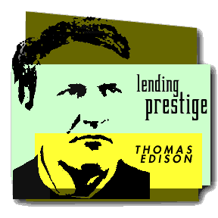
Early Cinema Timeline
1894: Thomas Edison (USA)
Edison’s Kinetoscope Films
Short, Vaudeville-like spectacles
for one person looking
into a kinetoscope

Slide 4
Early Cinema Timeline
Examples:
The Kiss
Sandow Flexing His Muscles
Boxing Cats
Pie-Eating Contest
Turkish Dance

Slide 5
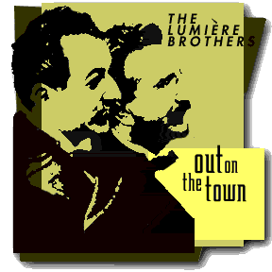
Early Cinema Timeline
1895: The Lumiere Brothers (France)
“The Birth of Cinema”
Short depictions of everyday life that were projected for an audience

Slide 6
Early Cinema Timeline
Examples:
The Arrival Of A Train
Workers Leaving The Lumière Factory
Watering The Gardener
Demolition Of AWall
Feeding The Baby
Children Digging Shrimp

Slide 7
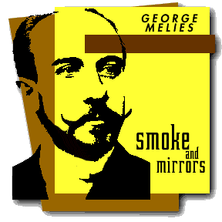
Early Cinema Timeline
1902: Meliès (France)
A Trip to the Moon
A magician who used:
Fantastic Sets
Costumes
Special Effects

Slide 8
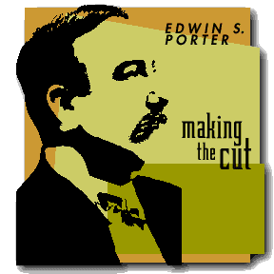
Early Cinema Timeline
1903: Edwin S. Porter (USA)
The Great Train Robbery
Famous American
Nickelodeon film

Slide 9

Early Cinema Timeline
1913: D. W. Griffith (USA)
Battle at Elderbush Gulch
Cross-Cutting
Close-Ups

Slide 10
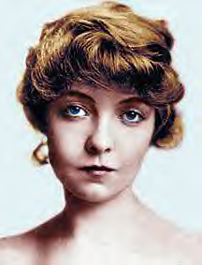
Question:
What are the most significant differences you see between films made before 1908 and those made after 1911?

Slide 11
Thoughts:
The first films are grouped by film theorists as PMR (Primitive Mode of Representation).
They place the spectator on the _____ of the diegesis (the world of the film), as if we are watching a stage play.
The camera tends to be _____. The emphasis is on the spectacle (i.e. watching).
Choose the correct term for the missing words: 1) outside / inside 2) moving / static

Slide 12
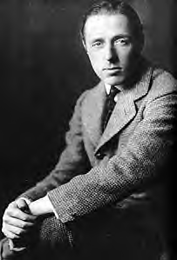
Thoughts
Elderbush has been been grouped by film theorists as being part of IMR (Institutio-nal Mode of Representation a.k.a. Classi-cal Hollywood Cinema).

Slide 13
Thoughts
Such films place the spectator _____ the diegesis (through such things as shot / re-verse shot, Cross-Cutting, etc.) as if we ______ participants in the action.
Choose the correct term for the missing words: 1) inside / outside 2) are not / are

Slide 14
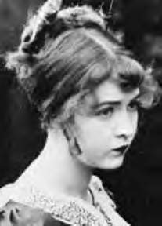
Question:
What racial, classed, and gendered stereo-types are depicted in Battle at Elderbush Gulch?

Slide 15
Question:
Connect the visual material to Lipp-mann’s articles on stereotypes.

Slide 16
Thoughts / Questions:
How is RACE depicted in Battle at Elderbush Gulch?
Notice the difference in the depiction of the white settlers and the Native Americans.
What kind of shots are used?
What is the meaning of the different shots?

Slide 17
Thoughts / Questions:
How is GENDER depicted in Battle at Elderbush Gulch?
Notice the figure of the white woman in trouble.
What is HER function?
Notice the figure of the strong white male.
What is HIS function?

Slide 18
Thoughts / Questions:
How is CLASS depicted in Battle at Elderbush Gulch?
Notice the settlers.
Where does the film position the spectator / viewer?
On which side is the viewer positioned?

Slide 19
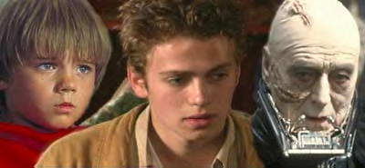
Finally…
All of this will be important as cinema continues both to reflect and to influence the nation. There will yet be greater things to come...

Slide 20
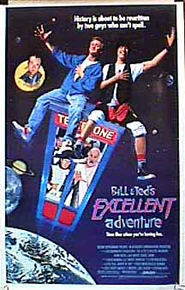
Finally…
Don’t worry if some things do not yet make sense! By the end of the semester, they will!
The two most important
things to remember:
Learn the technical vocabu-lary used in discussing film.
ENJOY the films with an OPEN mind
THE END

